Slide 2
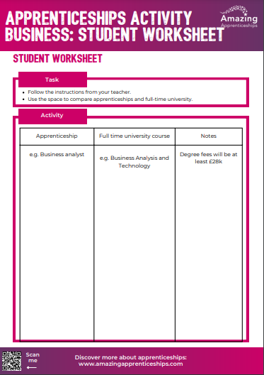
Apprenticeships – a good business decision
The number of apprenticeships available that link with business has grown significantly in recent years, as more and more companies realise the benefit of employing apprentices in a variety of roles and at different levels.
This lesson will be used to look at the different options between apprenticeships and studying full-time at university.

Slide 3
For this task you will research business apprenticeships and full-time university business degrees.
Using https://www.instituteforapprenticeships.org/apprenticeship-standards/, research some apprenticeships you can undertake in the Business sector.
Then use https://digital.ucas.com/search to look for related full-time degree courses.
While you are researching, make notes of any pros or cons for each.

Slide 4
Home learning
The apprenticeship levy is a mandatory tax-style payment that affects businesses with a payroll of £3m+ per year. More information can be found here https://www.gov.uk/guidance/pay-apprenticeship-levy You may also find this film useful https://www.facebook.com/watch/?v=184587352920524
Research the apprenticeship levy and create a poster or guide that could be used to give the key information to organisations that could transfer their levy, but aren’t doing so at the moment.
You will need to use the link above to understand what the apprenticeship levy is, and how businesses can use levy-transfer to support other organisations.

